Slide 1




INF2190
FINAL PROJECT PRESENTATION
Exploration of Government's Assessment Policy For Social Welfare Program (SWP)
Si Cheng, Giriraj Heda,Yijun Lin, Rohit Pandit

Slide 2
GROUP 13
Table of Contents
01
Introduction
02
Analysis
Discussion & Conclusion
03
04
Limitations

Slide 3
GROUP 13
Motivation
Understand measures taken by the government to support people during periods of recession, mass layoffs and brutal weather
Kaggle dataset- Unemployment and Mental illness
Survey collected by NAMI (National Alliance on Mental Illness)
Information about people's income level, mental health, physical conditions and other basic statuses
Aim to identify gaps in Government's current SWP distribution policy

Slide 4

GROUP 13
Introduction
Do you know about the Social Welfare Programs (SWP)?

Slide 5

GROUP 13
About Social Welfare Program (SWP)
SWP refers to programs set by the government that aim to help individuals that cannot support themselves. The benefits are usually granted in various ways such as compensation, food stamps and housing, etc.

Slide 6

GROUP 13
Problems faced by the SWP
Researches show that there are many issues around the SWP, among which two of them seem to be very critical problems to the entire SWP system
People who are extremely poor are usually missed
Improper payments or even frauds happen since the federal government fails verify the income reported by the applicant

Slide 7
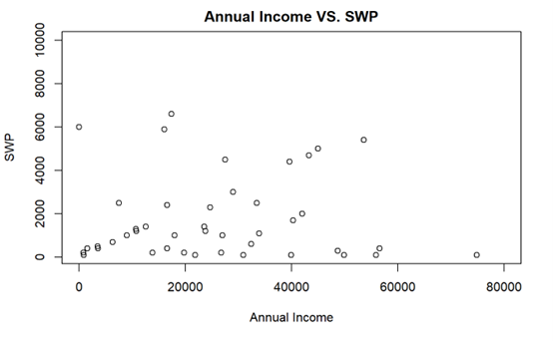

GROUP 13
Observations from the dataset

Slide 8

GROUP 13
Question:
Is the current assessment for receiving money under the Social Welfare Program (SWP) valid enough?

Slide 9
GROUP 13
Analysis

Slide 10

GROUP 13
Methods Applied
Stepwise backward selection
Logistic Regression for Machine Learning
Decision Tree
Random Forest
LEARN MORE

Slide 11

GROUP 13
Stepwise Backward Selection
14 Variables -> 9 Variables
Education, Disabled, Internet Access, Annual Income with last year SWP, Employment status, Read books (Extra skills), Times of hospitalization (Mental illness), Age, Household Income(Annual)
LEARN MORE

Slide 12

GROUP 13
Logistic Regression For Machine Learning
Whether the current variables are sufficient to predict probability of eligibility
Accuracy Results:
Test Model - 84%
LEARN MORE

Slide 13

GROUP 13
Decision Trees
Based on the selected features & individual’s background, can we model different approaches which can be used in determining the amount by using Decision Trees
LEARN MORE

Slide 14
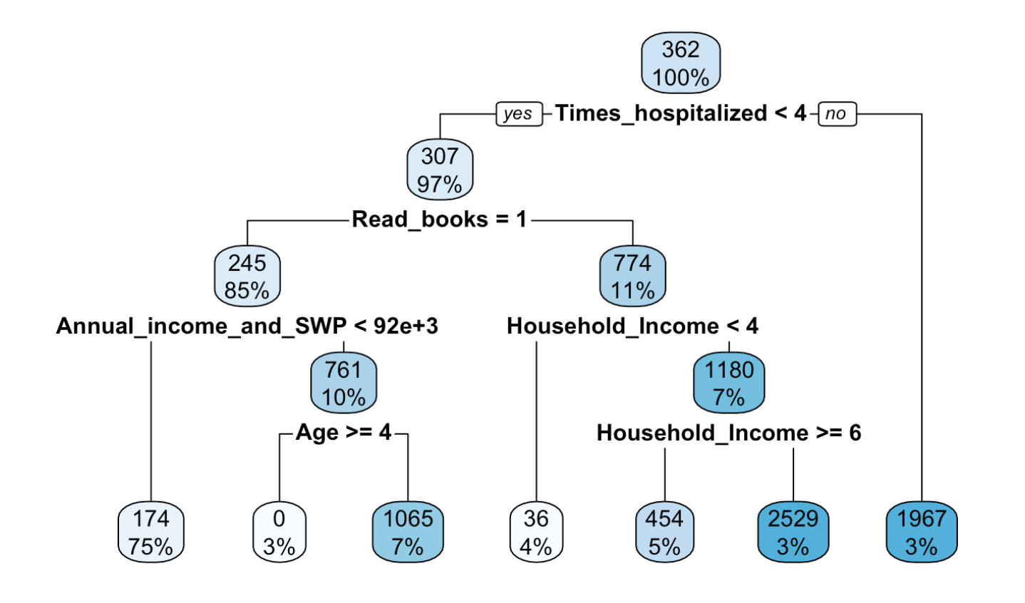

GROUP 13
Household Income:
$50,000-$74,999 -> 4
$75,000-$99,999 -> 5
$100,000-$124,999 -> 6
Age:
Greater than 60 -> 4

Slide 15

GROUP 13
Random Forest
Using the same variables used for constructing Decision Tree, can we predict the amount for the individual which should be awarded using the inputs
LEARN MORE

Slide 16


GROUP 13
Applicant 1
Jose
Completed Undergraduate, Unemployed, 60 years old
Factors
Disabled
No Internet Access
Does not read books
Annual Income = $1000
Number of times hospitalized = 20
Household income = $65,000
Predicted Results
90%
$2400
Receive SWP
Eligible Amount

Slide 17


GROUP 13
Applicant 2
Alice
Completed Master, Unemployed, 55 years old
Factors
Disabled
No Internet Access
Does not read books
Annual Income = $500
Number of times hospitalized = 8
Household income = $180,000
Predicted Results
87%
$1400
Receive SWP
Eligible Amount

Slide 18

GROUP 13
Inference
Based on our analysis from using Decision Tree and Random Forest, we can we can say that the current assessment policy of the government is not thorough enough and there are people in the social welfare program receiving money when they ideally should not be receiving it.
LEARN MORE

Slide 19
GROUP 13
Decision

Slide 20

GROUP 13
How can we make it better?
The eligibility check for individuals can include factors like employment status, disability status, and a proper evaluation of the individual household income
This will allow the government to determine the individual’s eligibility better and will benefit the actual people in need of this scheme
LEARN MORE

Slide 21
GROUP 13
Discussion & Conclusion

Slide 22

GROUP 13
Conclusion
We observed abnormalities while analyzing the test results, indicating a gap in the current SWP distribution policy
The efficiency of the distribution model can be improved by taking specific measures into consideration
Model re-evaluation can be considered to eliminate current inconsistencies and ensure efficient distribution under SWP

Slide 23
GROUP 13
Limitations

Slide 24

GROUP 13
Limitations
No background information about financial support from the individual's family
Eligibility for SWP grant based on a single factor

Slide 25

GROUP 13
Thank You

Slide 26
GROUP 13
Q&A

